Slide 1
Routes and Networks for Outdoor Navigation A Company Presentation
v.1.02

Slide 2
Our Mission
Enable OUTDOOR NAVIGATION,
making ROUTES and ROUTABLE NETWORKS available,
partnering with APPLICATION & NAVIGATION PLATFORMS,
CONTENT PUBLISHERS and REFERENCE DATA SUPPLIERS.

Slide 3
Our Position
Applications
&
Platforms
M
a
r
k
e
t
Content
Publishers
Reference
data
suppliers
Content
Publishers

Slide 4
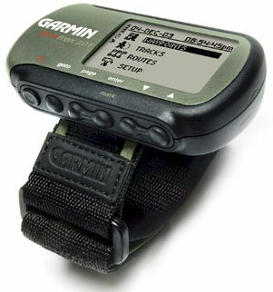
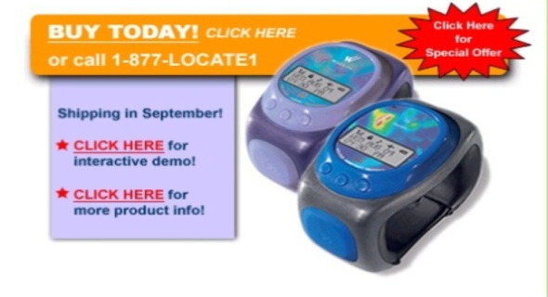
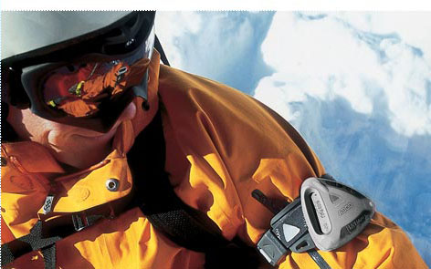
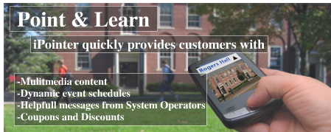
Outdoor Navigation It’s becoming “dedicated”
Virtual Partner™—lets you "race" a virtual competitor, making training fun
Notes:
From in-car to leisure, recreation, outdoor, tourism
New dedicated devices for specific “personal” means
Battery life, screen luminance, shock resistance, water proofness, … pose new hardware requirements

Slide 5
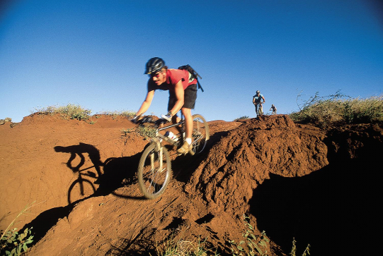
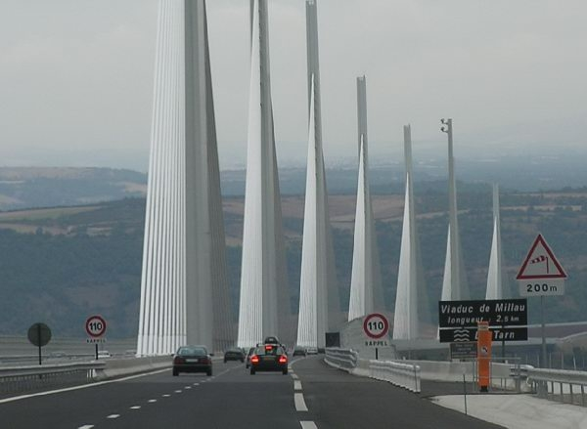
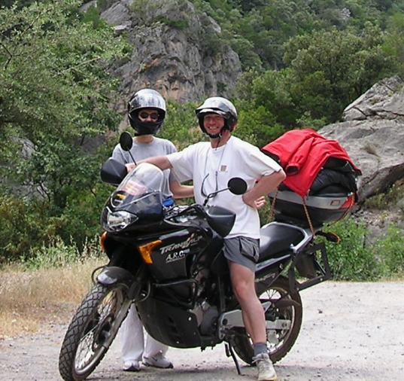
Outdoor Navigation It’s the Journey, not the Destination
INFOTAINMENT
SPORT
LEISURE
TOURISM

Slide 6
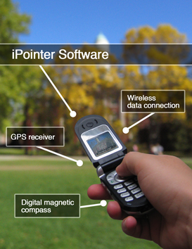
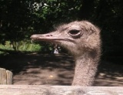
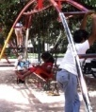
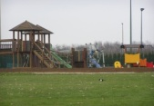
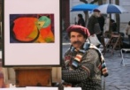
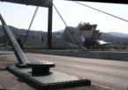
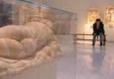
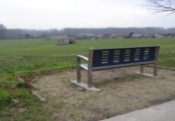
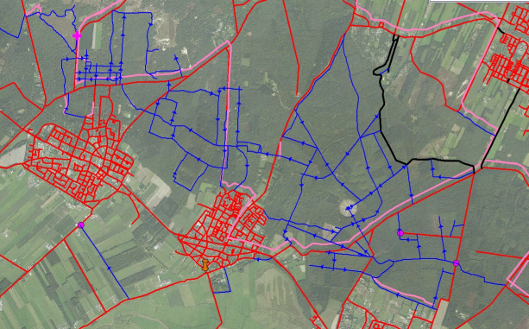
Outdoor Navigation It’s about Content, less about maps
Food & drinks
INFOTAINMENT
Activities, places
Landmarks
Things to do
SPORT
LEISURE
TOURISM
Notes:
Rich cartography: 2,5D, 3D, landmarks,
Extended routable networks with specific classifications for specific routing
Rich content integration and linking
The community as a crucial enabler
Web 2.0 as a facilitating concept

Slide 7
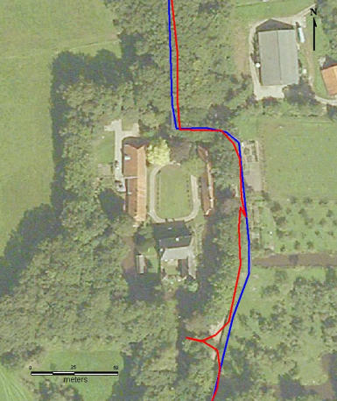
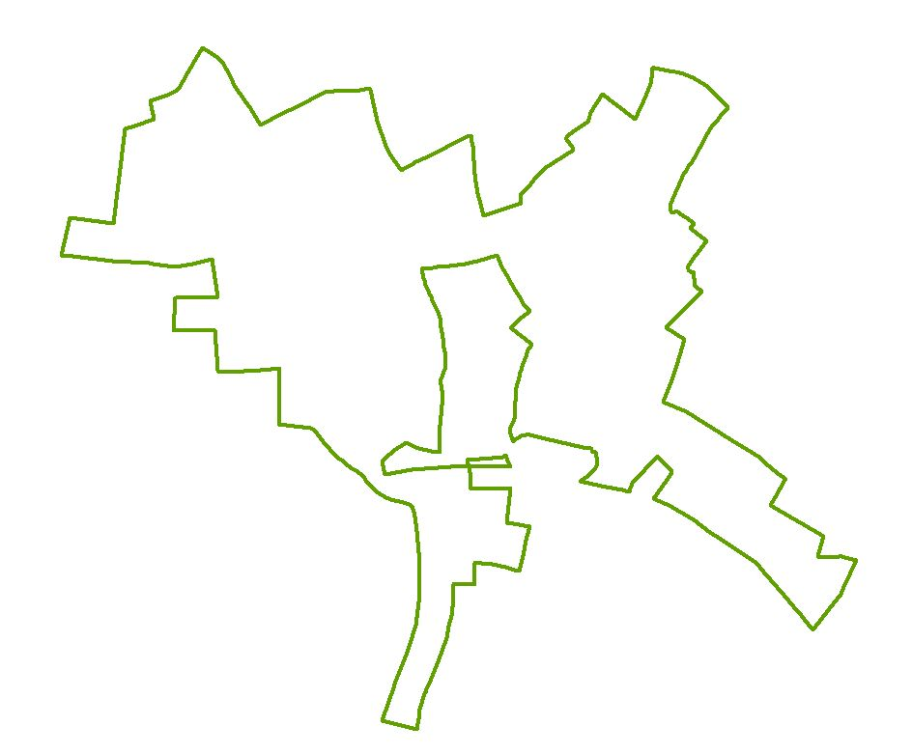
Routes Precise digitizing

Slide 8
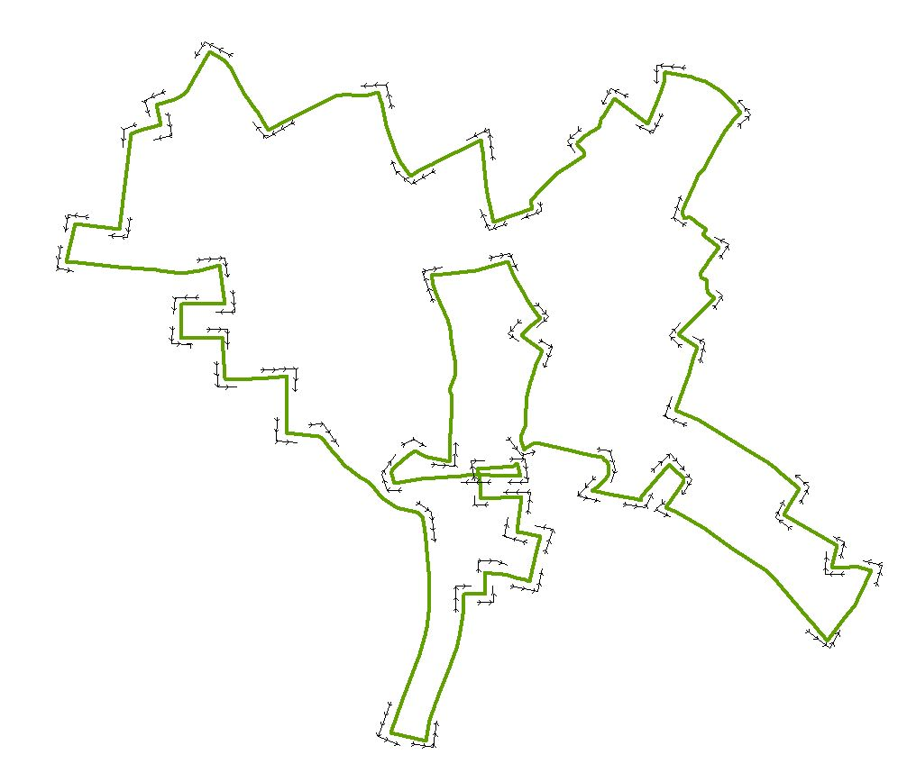
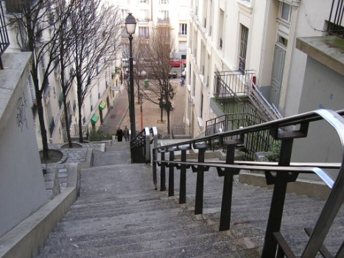
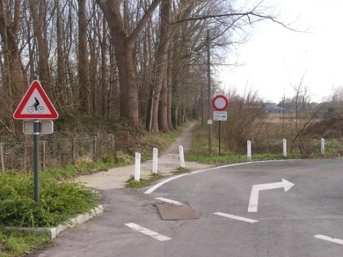
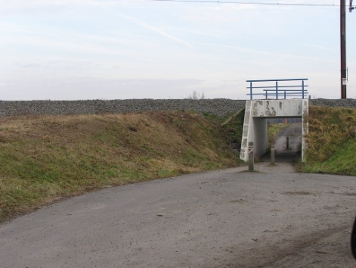
Routes Adding guidance

Slide 9
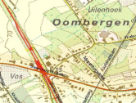
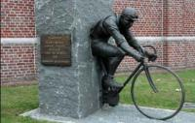
Routes Structuring editorial info
POI-TYPE
TOPIC
Tekst
eenheid
Tekst
eenheid
Tekst
eenheid
Tekst
eenheid
LOCATION
LOCATIONS
RELATIONS
EVENT-TIME
MM-FILES

Slide 10
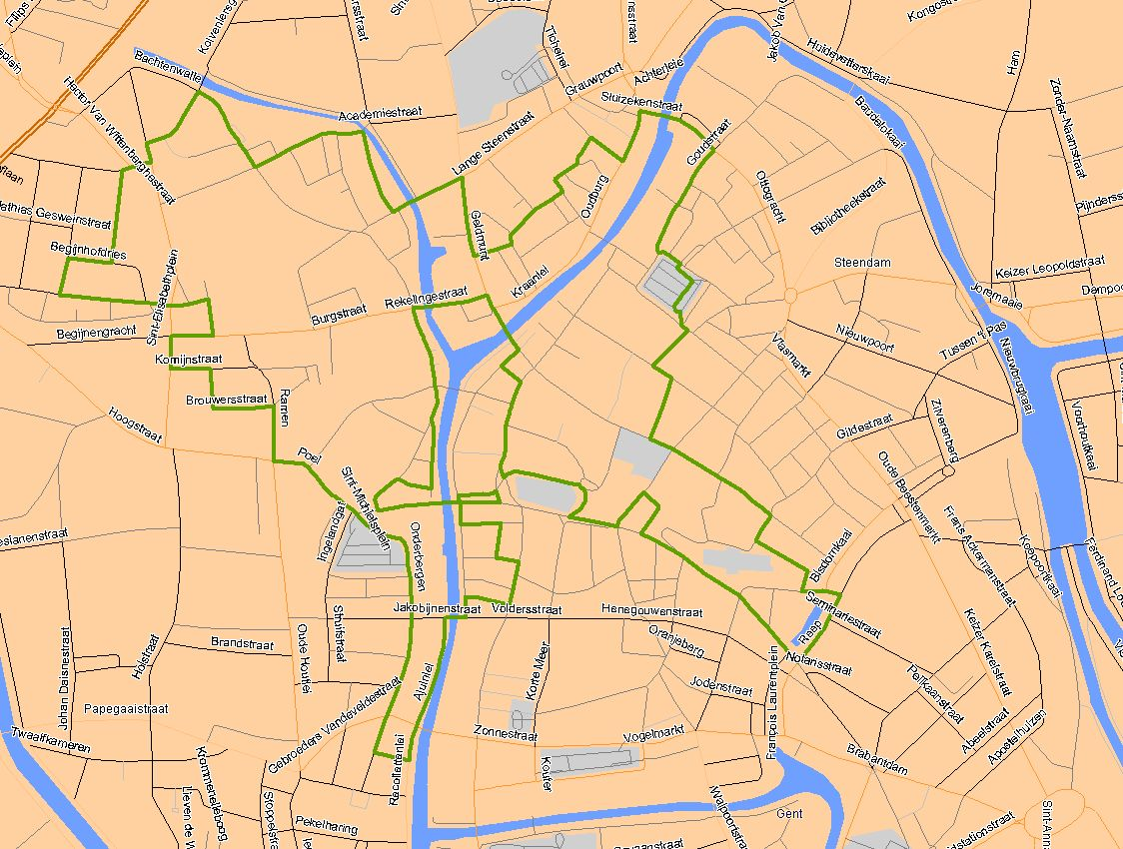
Routes Geocoding editorial content
Als versterking tegen de vikingen bouwde de graaf van Vlaanderen in de tiende eeuw een motte (houten burcht), voorganger van het Gravensteen uit de twaalfde eeuw. Eromheen leefden zijn horige leerwerkers. In de motte werd de oogst van de naburige …..
De textielbaron Juliaan Van Damme liet in 1911in het Drongenhof, aan de rand van het Patershol, een prachtig Art-Nouveau handelshuis bouwen. ..
De Vrijdagmarkt wordt sterk geassocieerd met Jacob van Artevelde, maar voor een lange tijd stond hier het standbeeld van Keizer Karel kunnen zijn.
Tijdens de tweede helft van de 19de eeuw werd de druk van de uitdeinende bevolking op dit begijnhof alsmaar groter. De stedelijke overheid werkte urbanisatieplannen uit waardoor het Sint-Elisabethbegijnhof zijn gesloten karakter verloor.
De Stad Gent en de afdeling Bovenschelde van het ministerie van de Vlaamse Gemeenschap hebben het plan opgevat om de gedempte Nederschelde tussen het Bisdomplein en de Nieuwbrugkaai opnieuw open te leggen en zo de vroegere monding tussen Schelde en Leie opnieuw te herstellen.
Hugo Claus verhuist zo'n dertig keer in zijn leven. Hij leefde ook een tijdje in Gent. Zijn geliefde café-plijsterplaats was de Hotsy Totsie aan de Poel.
De Sint-Baafskathedraal puilt uit van de kustschatten.
Het bekendst is ongetwijfeld "Het Lam Gods", het meesterwerk van de Vlaamse primitieven Hubert en Jan Van Eyck uit 1432. Dit kunstwerk werd geschilderd in opdracht van Judocus Vijdt, voorschepen van de stad Gent. Het werk was aangevat door Hubert Van Eyck, maar die overleed in 1429. Jan Van Eyck werkte het verder af.
In de Gentse Veldstraat en haar wijde omgeving bevond zich de hoogste concentratie aan (al dan niet verdachte) Rendez-vous huizen en publieke huizen. Met vier rendez-vous huizen, veertien verdachte
Het "Waterhuis aan de Bierkant" heeft een prachtige locatie aan de Leie, en een heerlijk terras bij mooi weer. Dit knus, bruin café biedt meer dan 150 biersoorten aan, maar je kan er ook terecht voor een hap.

Slide 11
Routable Networks Principles
Routing on traditional navigation networks (Tele Atlas, Navteq) is not sufficient for outdoor route planning:
Networks contain hardly information on outdoor characteristics
Route calculation focused on cars, fastest, shortest
Network lacks roads and paths important for outdoor
Solution:
Classification of the network for outdoor use (biking, cycling, walking)
Extension of the network with most important road and path connections

Slide 12
Network Classification Approach
Tele Atlas network is re-classified for different kind of outdoor routing on basis of the following principles:
More than 30 Tele Atlas attributes are used to calculate and associate a resistence for walking, cycling, biking, … to each of the road elements. Examples of attributes that influence the resistence for cycling:
+ Part of wood - Part of industrial area
+ Along water - Higher road class
Existing tracks on the internet are analyzed and evaluated in terms of popularity
Routes digitized on RouteYou are analyzed and evaluated

Slide 13
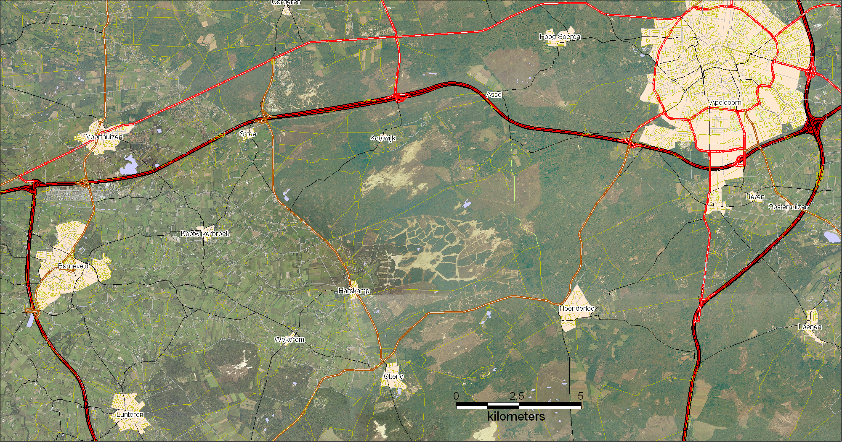

Slide 14
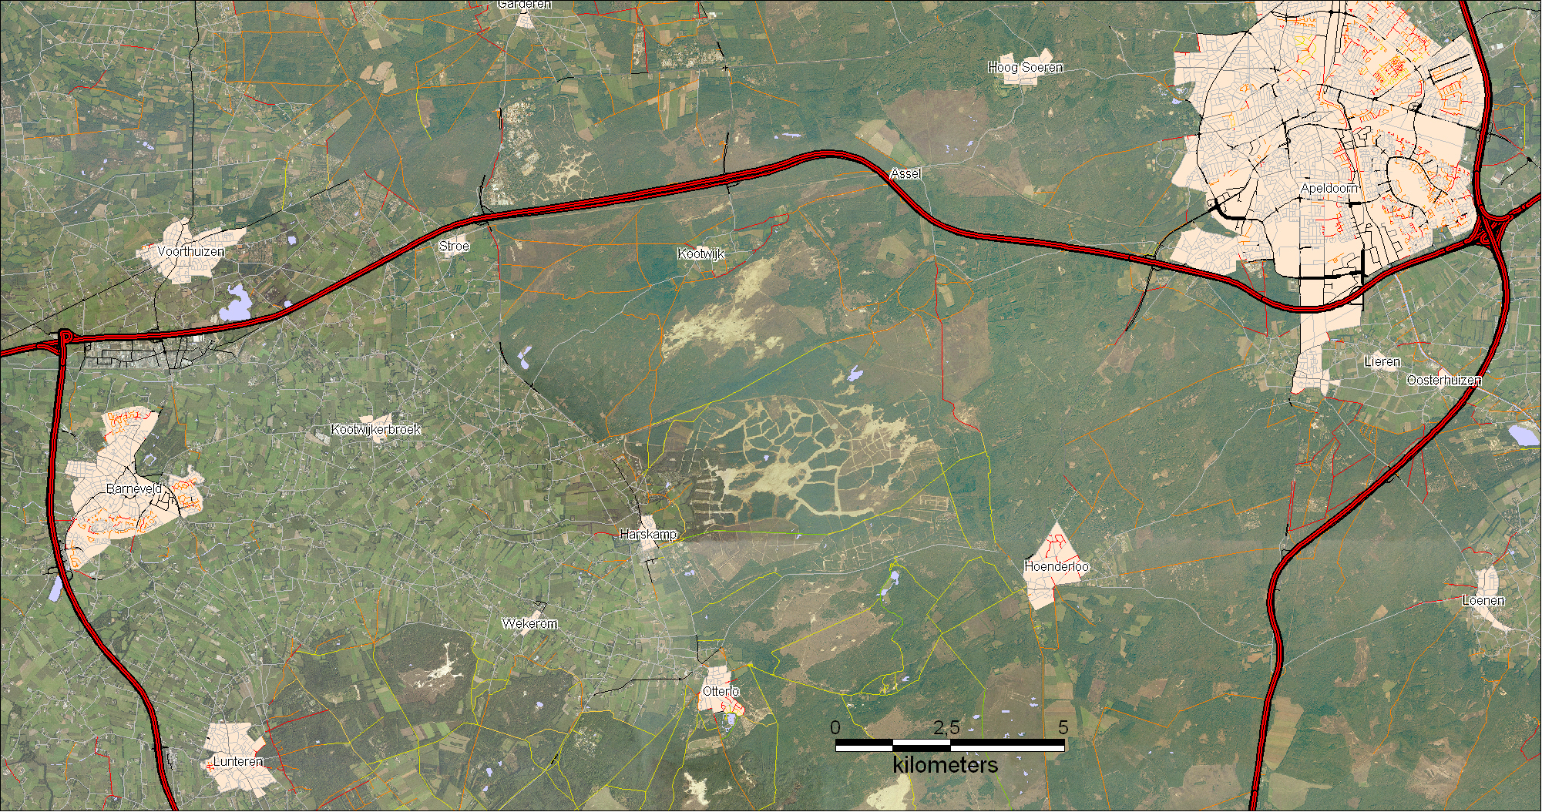

Slide 15
E
S

Slide 16
E
S

Slide 17
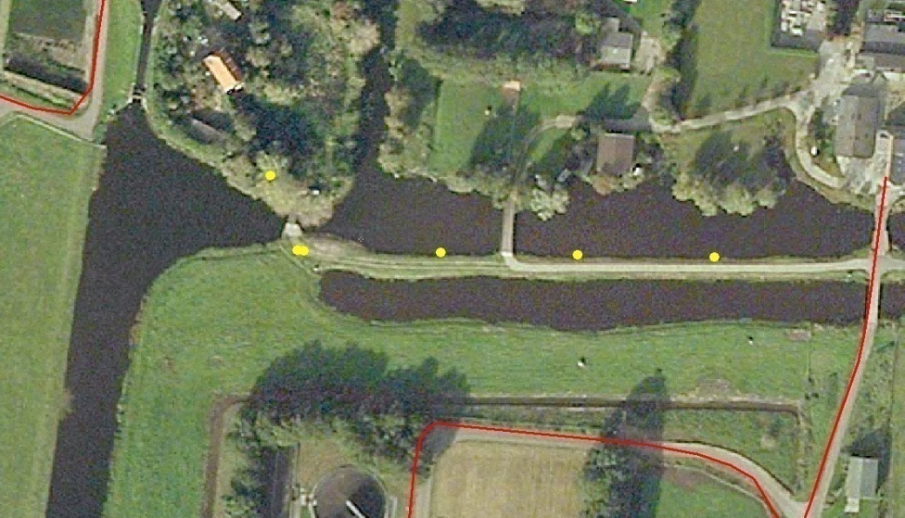
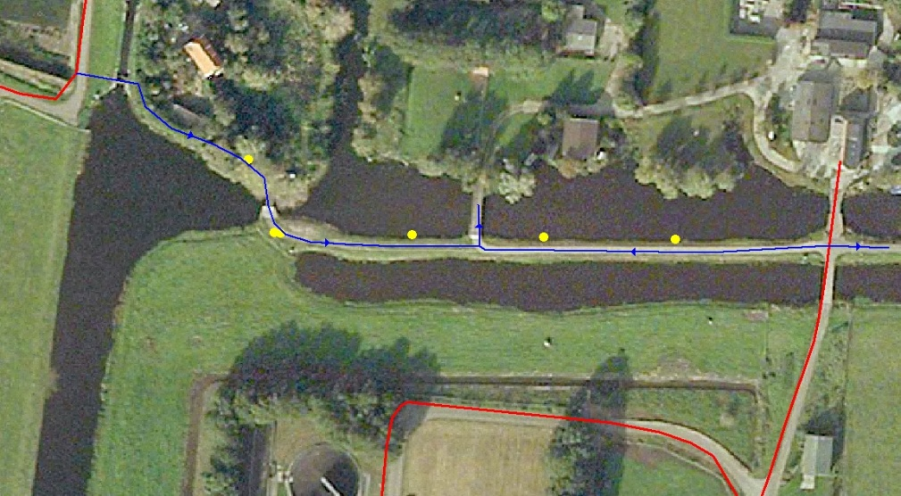
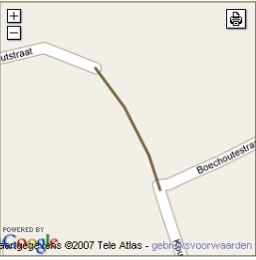
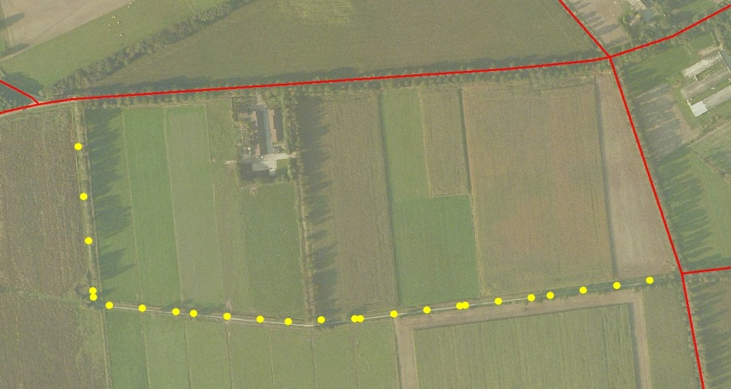
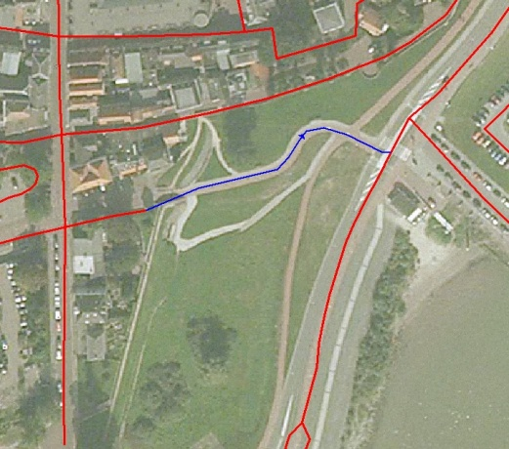
Network Extension Missing links/geometry

Slide 18
Network Extension E.g. de Utrechtse heuvelrug

Slide 19
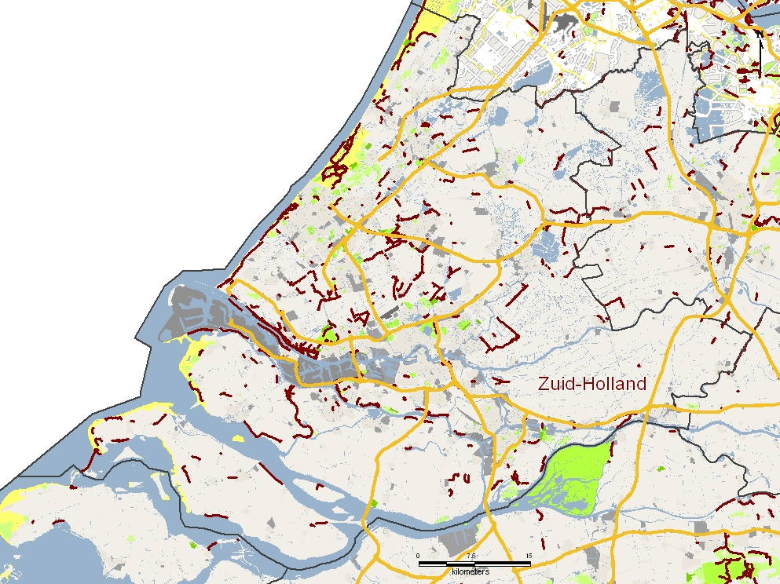
Network Extension e.g. Nederland

Slide 20
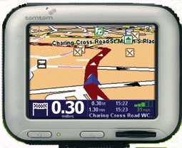
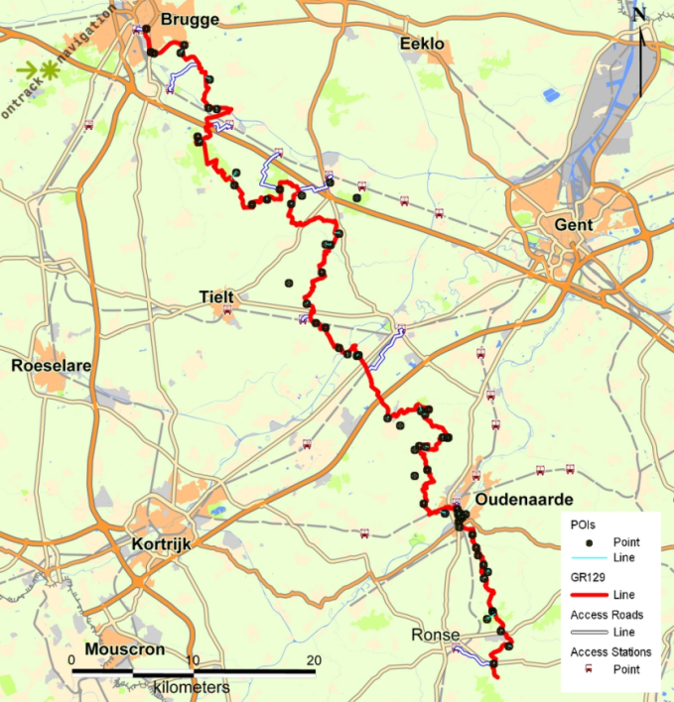
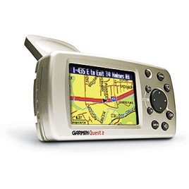
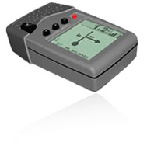
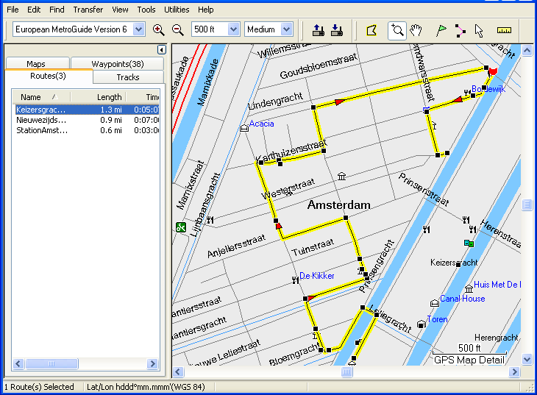
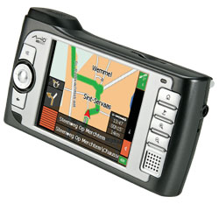
Partnering With application & navigation platforms
For platform specific product development of:
Tracks
Waypointlists
TbTRoutes
Routable Networks
…

Slide 21
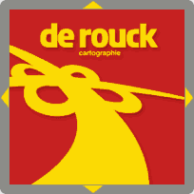
Partnering With content publishers
Publishing their routes
Accessing editorial content
Updating
Bundel sales and distribution

Slide 22
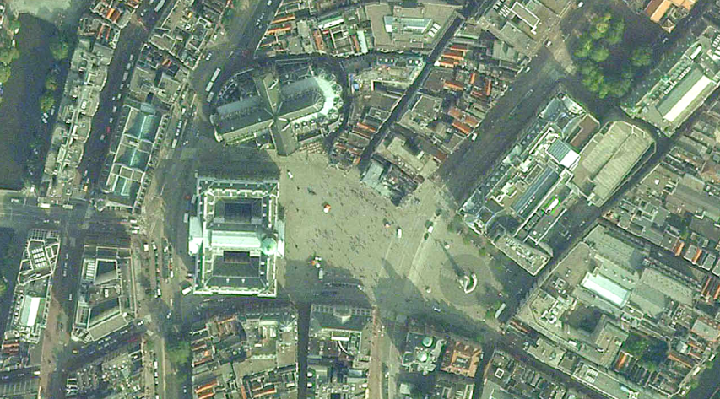
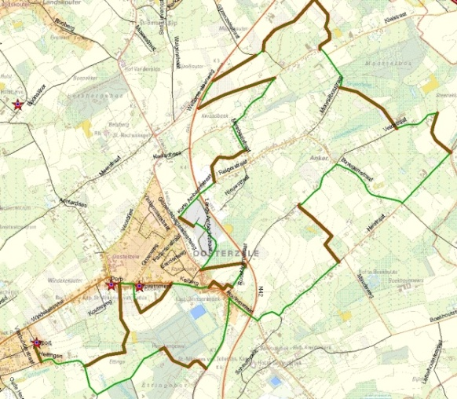
Partnering With reference data suppliers
For production and data integration
Tele Atlas Vector Maps
NGI raster maps
Aerial Imagery Aerodata, NGI
Google Maps
…

Slide 23
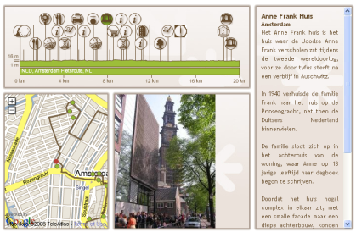
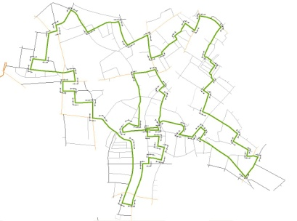
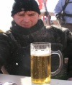
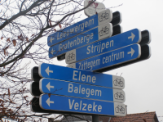
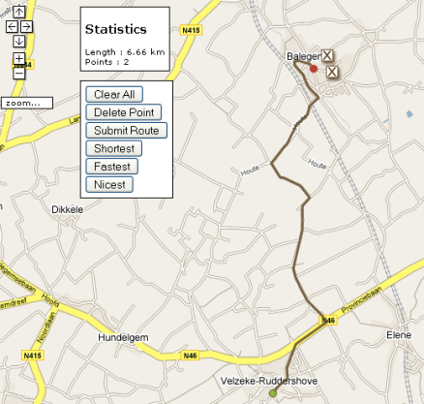
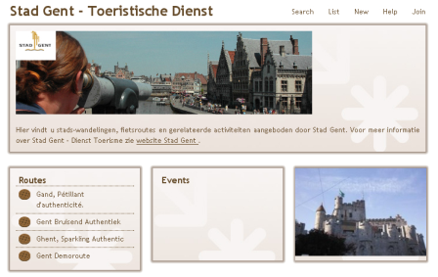
Our Business Concept
SERVICES
WEBSITE
PRODUCTS
PRODUCTION
VIEWER
B2C WEB PRODUCTS
PLANNER
HOSTING
BUNDLE PRODUCTS
FORMAT CONVERSIONS
PUBLISHER

Slide 24
Our Business Concept General
Our business concept is based on the following paid services and product selling:
Online Consumer Business
Production & Engineering Services
Advertizing Services
Web Services
B2B route and network sales

Slide 25
Business Concept Online consumer business
A selection of professional high quality routes is offered as payable download on the website of RTY. All revenues are shared with the owner of the routes. E.g.:
Lannoo Motor routes
Nordic walking routes Step Away
....
Specific products that can be associated with certain routes will be sold online via RouteYou.com. E.g.:
Reselling teh Lannoo Motormap
Offering a specific arrangement associated with a route
....
Specific website functionality will be offered as a service on basis of subscription models. E.g.:
Download of routes in specific platform formats
Routeplanning and printing on NGI topomaps as a reference
Routeplanning along specific networks
....

Slide 26
Business Concept Production & Engineering Services
To enable publishers, authors, platforms or user groups to publish their own routes on RouteYou, RTY sells specific production and engineering services:
Production and publishing of routes on RouteYou.com (e.g. City walk Ghent)
Development and online support of specific download formats
Production and development specific routable networks (e.g. Cycling network for Garmin)
Production and development of specific route planners (e.g. Along a specific network (e.g. a regional cycling node network)

Slide 27
Business Concept Advertising Services
To enable publishers, authors, platforms or users to publish advertisements on RouteYou.com , RTY offers a number of advertisement possibilities on the website:
Context related advertisement via Google Adwords
Site related advertisement via Google Adwords
Site related advertisement directly via RouteYou
Route and group related advertisement via RouteYou:
In the header of a group
In the header of a route
As a POI along a route

Slide 28
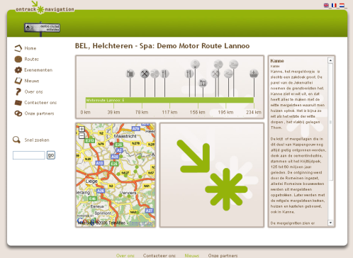
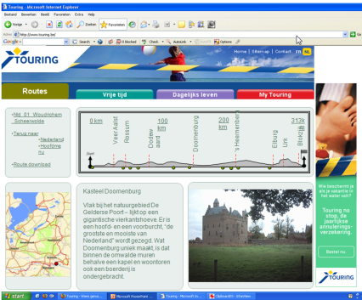
Business Concept Web Services
To enable publishers, authors, platforms and user groups to offer the RouteYou functionality integrated in their own website, RTY offers a number web services:
Standard route viewer plug in for individual routes published on RouteYou. Fixed lay out. Purchasing or downloading via the RouteYou website. Including all direct advertisement that is route related.
Route viewer plug in with customizable lay and download support via RTY.
Route Planner plug in with customizable lay-out
Full platform integration in the client’s website

Slide 29
Web Services Standard Viewer

Slide 30
Web Services Customized Viewer

Slide 31
Web Services Standard Planner

Slide 32
Business Concept B2B Route and Network Sales
To enable publishers, authors or platforms to resell or use the routes and specific routable networks of RouteYou, we offer different distribution possibilities to our business partners:
Bundle
After Market
Online
Revenue is shared with all parties that contributed to the product.

