Slide 1
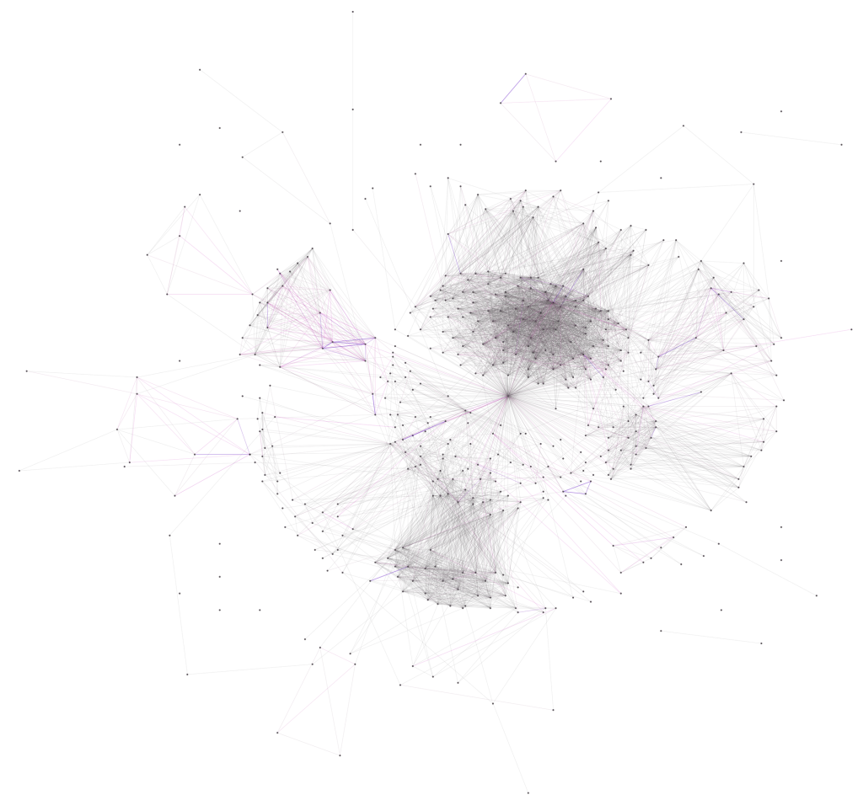
The RouteYou Communities for Outdoor Navigation
v.1.00

Slide 2
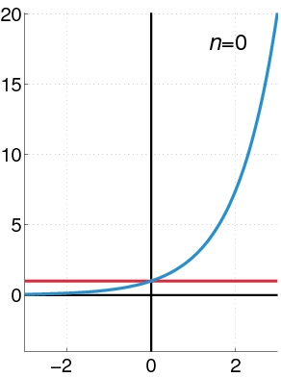
The strength of the community

Slide 3
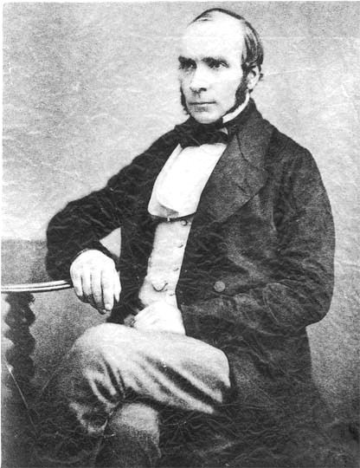
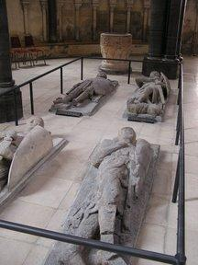
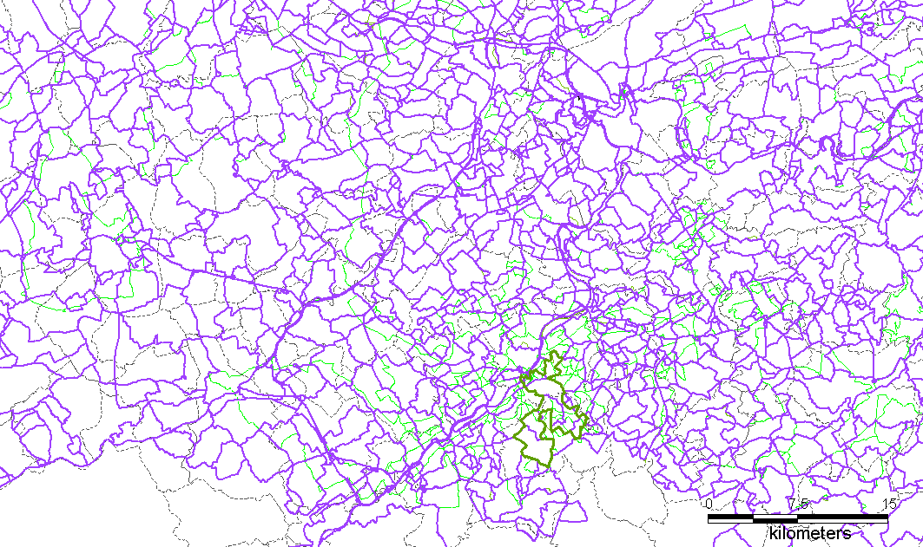
Linking information & people

Slide 6
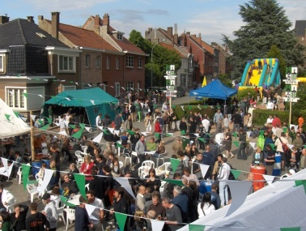
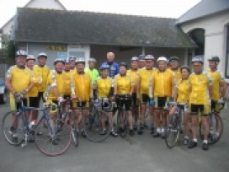

Slide 7
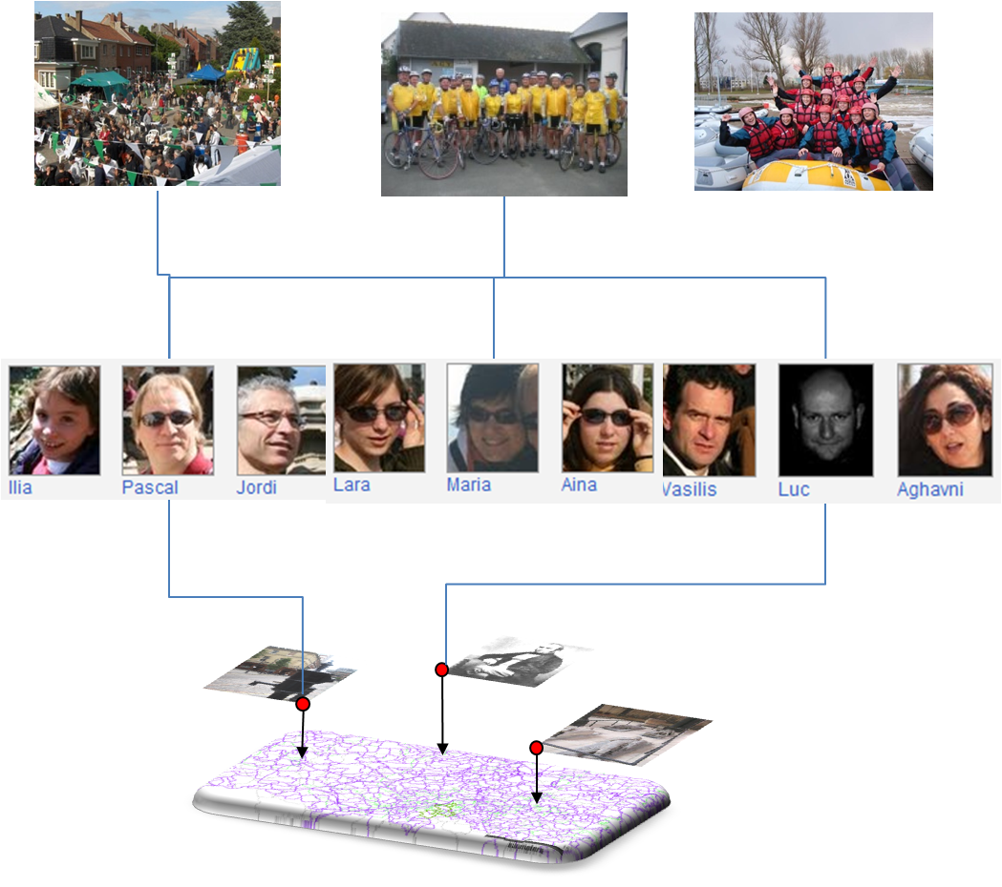

Slide 8
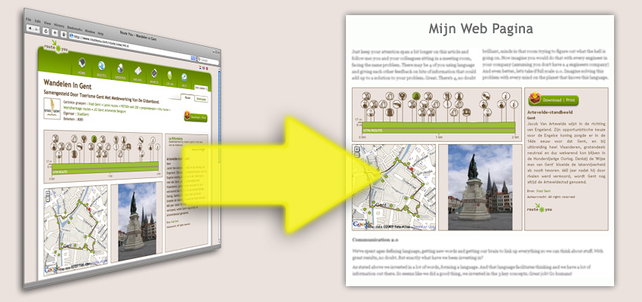

Slide 9
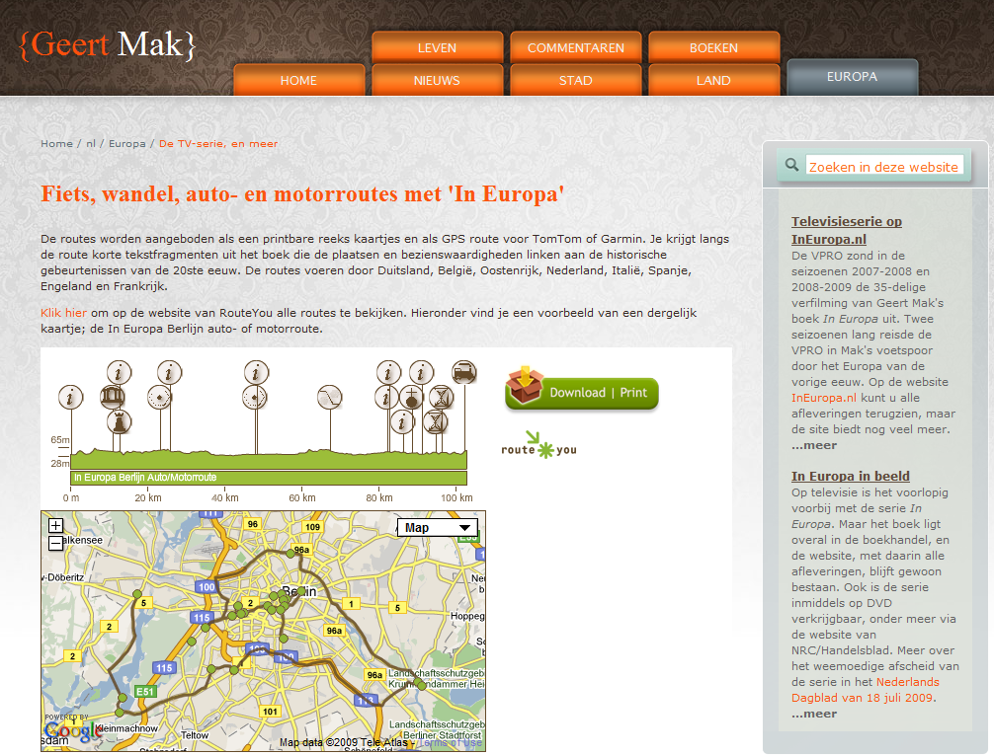
Link

Slide 10
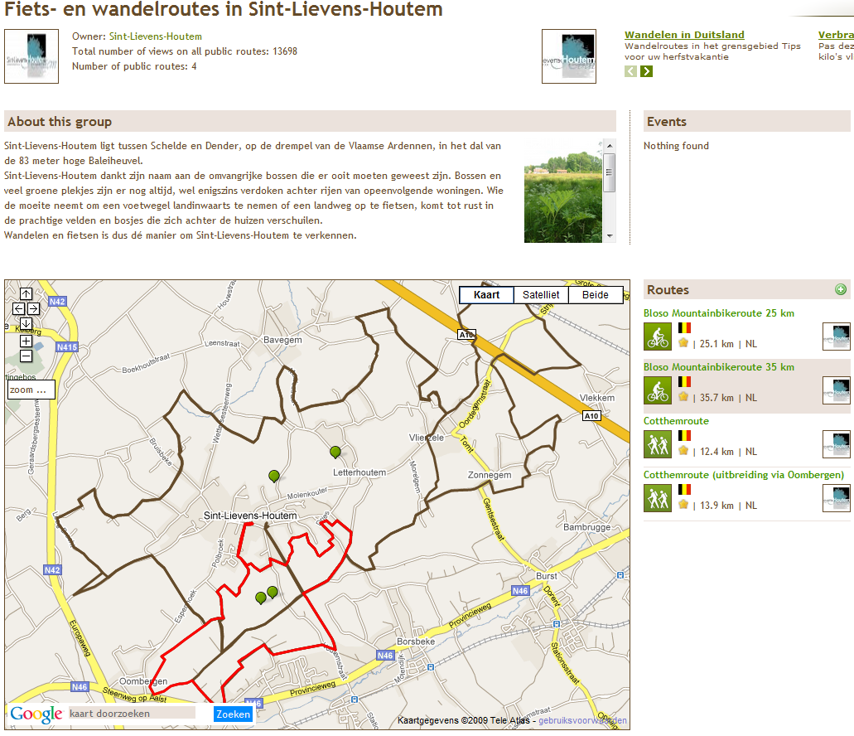
Exposure of your project on RouteYou
Link

Slide 11
Network effect in stats
1.6 million visits RTY web
29.714 sources plugged in a RTY widget
5.321 linked to RouteYou
2.6 million visitors (unique) on RTY
4.0 million visits

Slide 12
Network effect in stats
1.6 million visits RTY web
29.714 sources plugged in a RTY widget
5.321 linked to RouteYou
85 000 registered users

Slide 13
Network effect in stats
72 000 routes created via RTY web
103 000 routes created on RouteYou
Routes were viewed 1.3 million times

Slide 14
Network effect in stats
3 482 groups are created

Slide 15
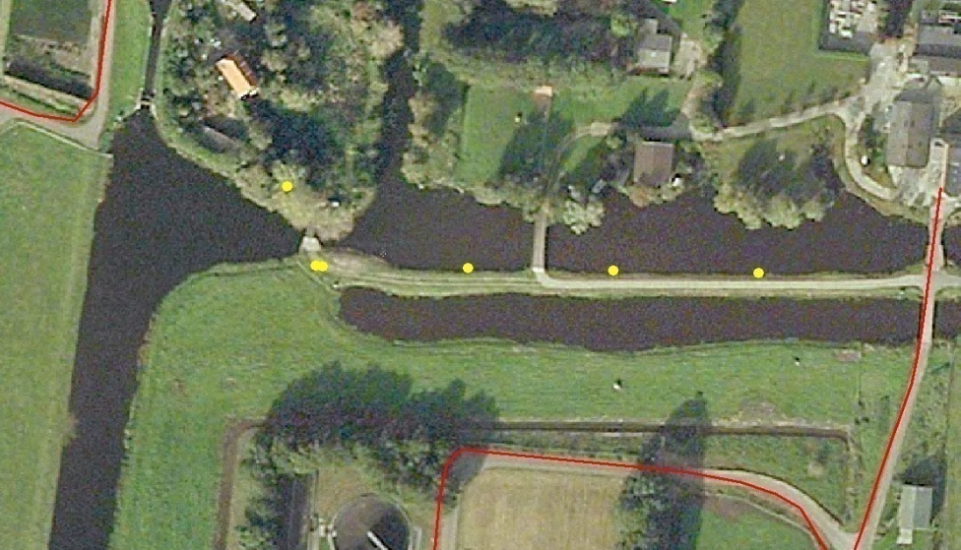
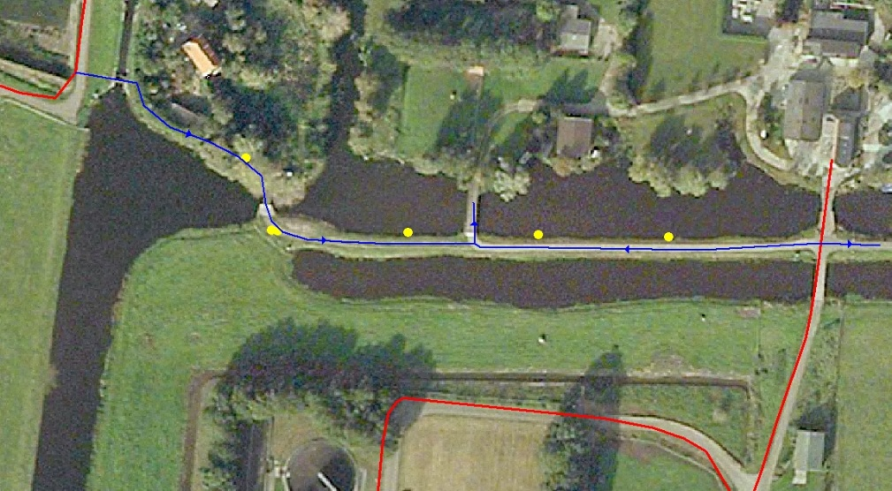
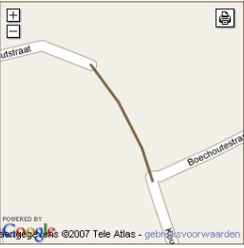
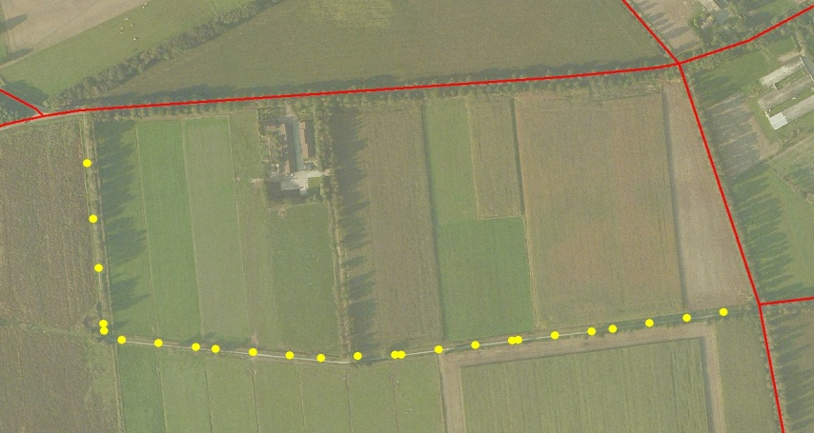
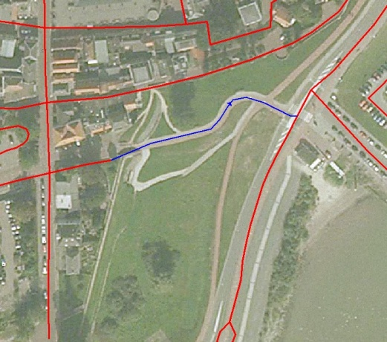
Network Extension Missing links/geometry

Slide 16
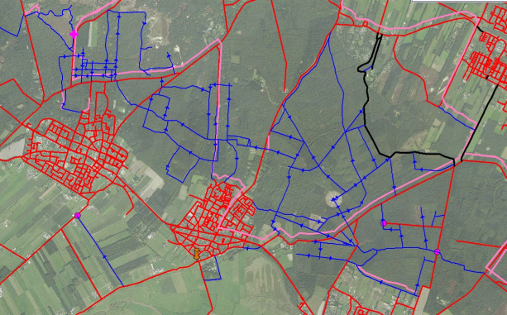
Network Extension E.g. de Utrechtse heuvelrug

Slide 17
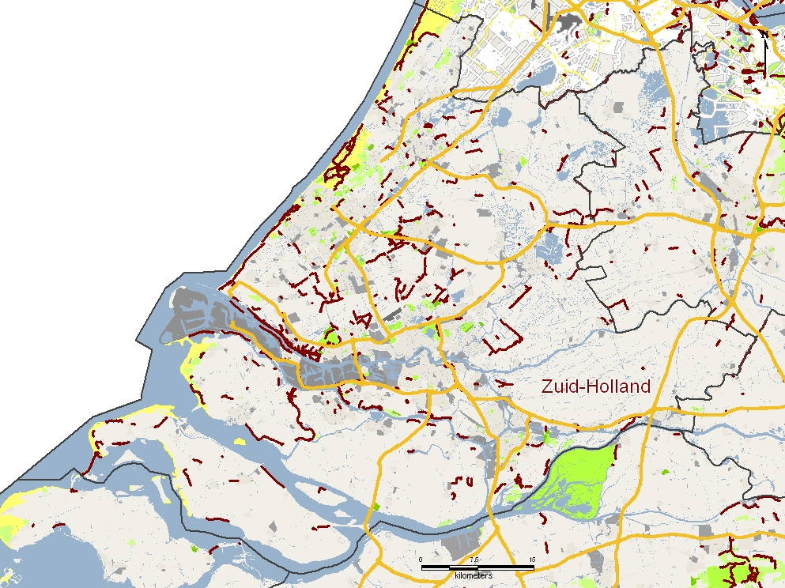
Network Extension e.g. Nederland

Slide 18
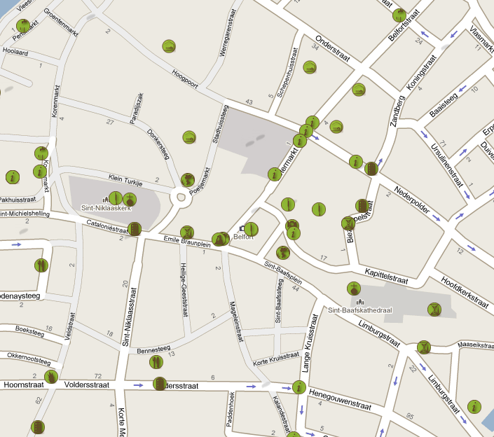
POI sets

Slide 19
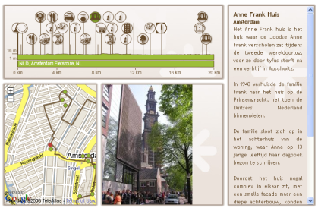
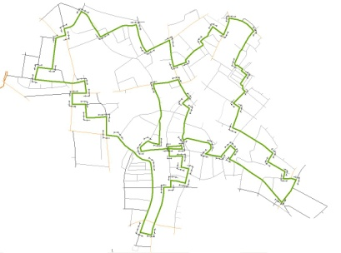
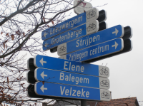
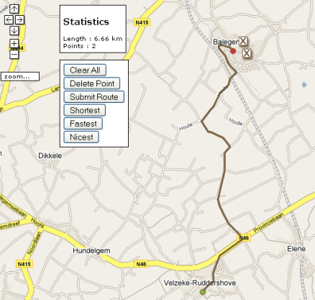
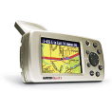
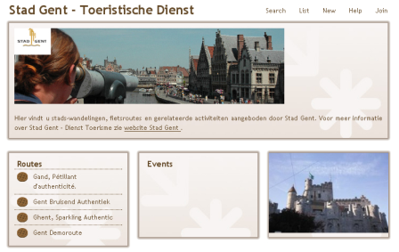
Technical structure
SERVICES
WEBSITE
PRODUCTS
PRODUCTION
VIEWER
B2C WEB PRODUCTS
PLANNER
HOSTING
BUNDLE PRODUCTS
FORMAT CONVERSIONS
PUBLISHER

